Slide 1

GymGuard
T – 1 Week Presentation

Slide 2
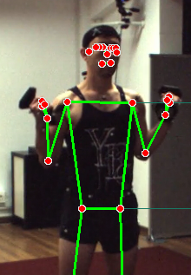
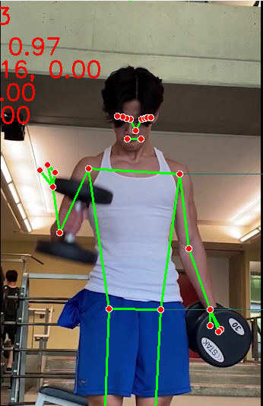
Threshold Critique Method
Problem Question:
How to make POV-Free Critique?
For example,
Both figure have similar 2D angle of ~30 degrees.
(Same applies to our decided metrices of area, angular velocities)
Real angle: 30
Real angle: 90

Slide 3
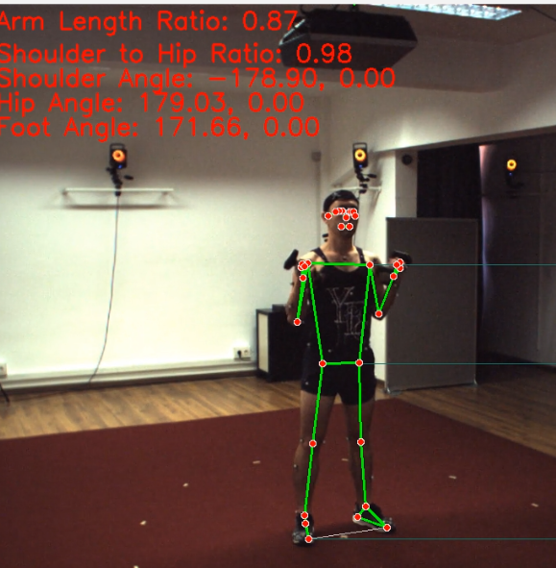
Potential Solutions (1/2)
Solution 1:
Use time-based or ratio-based critique:
Ground: ‘it takes about 2.4s from valley to peak of a joint angle’ Deduce: If time is off from this, then there is an issue. Ground: ‘there is X inch² during the valley, and Y inch² during the peak, ratio of difference is X:Y’ Deduce: If ratio is off from this, then there is an issue.

Slide 4
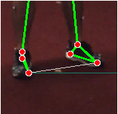
Potential Solutions (2/2)
Solution 2:
Use translation angle to find rotation of joint: ‘if joint is X degrees from this 2D POV and translation angle is ty degrees, then the actual angle should be Xty degree’
Compare Xty with Ground Xground
Translation Angle using ankles

Slide 5
Identification Model Discussion
Question: What should be your focus of improvement, False Positives or False Negatives?
Answer:
The right balance of FN and FP. To find balance we can use:
Cost-Sensitive Learning: Assign higher weights to misclassifications that are more detrimental (e.g., higher weight for FP).
Multi-class vs. Hierarchical Classification: If some exercises are more similar, we can consider a hierarchical structure where the model first identifies broad categories and then refines within them to reduce confusion.

Slide 6
What is Cost Sensitive Learning?
Subfield of machine learning that acknowledges the varying significance of errors made by the model.
In traditional machine learning, the focus is on minimizing the overall error rate, treating all mistakes equally.
However, cost-sensitive learning recognizes that certain errors have a greater impact or "cost" than others.
Although all of these implementations goes beyond the scope and timelines as of now

Slide 7
What next?
Exercise Identification Model – [Complete with limitations]
Threshold Identification Model – [Incomplete, Drafted method]
Standalone Client App – [Windows Complete]
Standalone Server App – [Complete]
Final Product - [Pending]

Slide 8
Limitations
Mediapipe’s limitation – Sometimes the 2D pose estimate is not always accurate.
“2D Image” limits the area of operation.

